Slide 1
DATA WRANGLING AND DATA ACQUISITION
Created using Colab
-Nivedita Patil

Slide 2
Import Library
Import pandas as pd.
Import numpy as np.
Import matplotlib.pyplot as plt.
Import seaborn as sns .

Slide 3
Downloading & Merging of Datasets
Downloaded dataset 1.
Downloaded dataset 2.
Downloaded dataset 3.
Merged dataset 1 & dataset 2 and created
a new dataset 4.

Slide 4
Different type of functios
info()
describe()
isnull().sum()
duplicated()
columns & unique()
mean().round()
fillna(df2['atemp'].mean().round(2),inplace= True
drop(['dteday'],axis=1,inplace=True
merge()

Slide 5
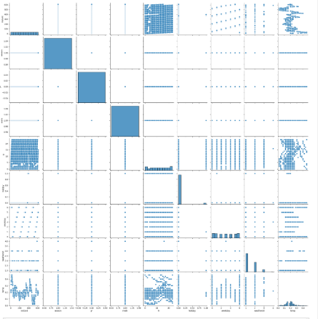
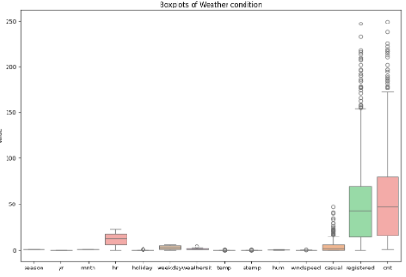
Types of Plots
pairplot
Box plot
sns.pairplot

Slide 6
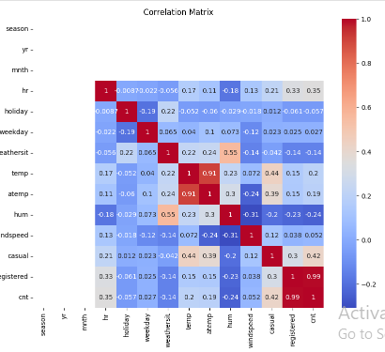
Heat Map

Slide 7
Other functions
corr()
skewness
kurtosis

Slide 8
Conclusion:
This project helps to find a statistical concept that measures the relationship between two or more variables and data sets.

Slide 9
THANK YOU
Notes:
Th

